Slide 1
Weather app (Minor Project)
Submitted by: Disha
Submitted to: Mr. Vipin Kumar Rathi
Session = 2022-2026

Slide 2
Table of CONTENTS
Introduction
Project Plan
Technologies used
Key features
Setup & Installation
Why I consider building a weather app?
Challenges overcome
Future improvements

Slide 3
INTRODUCTION
A simple weather app built using HTML, CSS, JavaScript, and node.js that provides real-time weather information for any city around the world.
The app fetches weather data from the OpenWeatherMap API and displays weather conditions like the current temperature, humidity, and wind speed
In this weather app project, users can enter any city name to get the 5-day weather forecast or click on the “use current location” button to get their current location’s weather details, including temperature, wind speed, humidity, and more.
The website/app provides a better time-saving and efficient way of keeping the user's interest. This project is also mobile-friendly, which means it looks great on all devices.

Slide 4
Project Plan
To create a weather app using HTML, CSS, and JavaScript, we need to follow these steps:
Create a folder. You can name this folder whatever you want, and inside this folder, create the mentioned files.
Create an index. HTML file. The file name and its extension must be indexed. Html
Create a style. CSS file. The file name must be style and its extension .CSS
Create a script.Js file. The file name must be the script and its extension.
The website was built using Visual Studio code as it is a streamlined code editor with support for development operations like debugging, task running, and version control. And it can run on any computer system. we divided the whole project into three main modules: index.html,script..js, and style.css.
The code includes a weather app header, input, button, and unordered list (ul) that are used as a placeholder for the weather details whereas the CSS file has all the styling portion of the website
Which is used to design the overall website look Later, using Javascript, we’ll replace these placeholders with actual weather details.
Script code will make your weather app functional, there are two API calls. The first one fetches the geographic coordinates of the user-entered city. These coordinates are then used in the second API call to retrieve the weather forecast, which is displayed on the page.
The code also includes a feature that asks for user location permission and, once granted, makes the second API call to fetch the weather forecast based on the user’s current location.
We will get an error like “invalid API key” or something when we don’t set the API key so we need to set the API key using openweathermap by creating an account at https://home.Openweathermap.Org/api_keys.

Slide 5
Technology Used
Front-end development (HTML, CSS, Javascript ).
Back-end development ( Node.js ).
Tester
UI/UX developer
Openweathermap API (for weather data)
HTML5 geolocation API

Slide 6
Key Features
It improves people's standard of living by giving them all information about the weather in the desired location.
It has a feedback option also which will help the admin to improve as per the demand of the user.
It allows us to view weather-changing metrics in a summarized way. This website can be accessed anytime, anywhere, and by any device.
It also filters out the result by using the current location.
It has a secure layer of sockets (ssl) to encrypt information that needs to remain secure.
It provides some other social media handles to connect.
Provide the user with adequate help by the user manual with the website/app.
"Search location" dialog box features help the user to find their location on the map.
It provides five days of weather forecast data.
It provides trustworthiness and privacy to the user.

Slide 7
Setup & installation
You can easily set up this weather app locally by following these steps: prerequisites • A modern web browser (e.g., Chrome, firefox, safari, edge).
Clone the repository (optional)
If you want to clone the repository and run it locally, follow these steps: 1. Clone the repository: git clone https://github.Com/yourusername/weather-app.Git cd weather-app 2. Open the index. HTML file in your browser. You don't need any server or backend for this app since it's fully frontend-based.
API key integration
This app uses the openweathermap API to fetch weather data. If you're planning to use it for personal purposes or modifications, you may need to create your API key by signing up at OpenWeatherMap.
Once you have your key, you can replace the existing API key in the Javascript file. Const Api key = "YOUR_API_KEY_HERE"; // replace this with your API key.

Slide 8
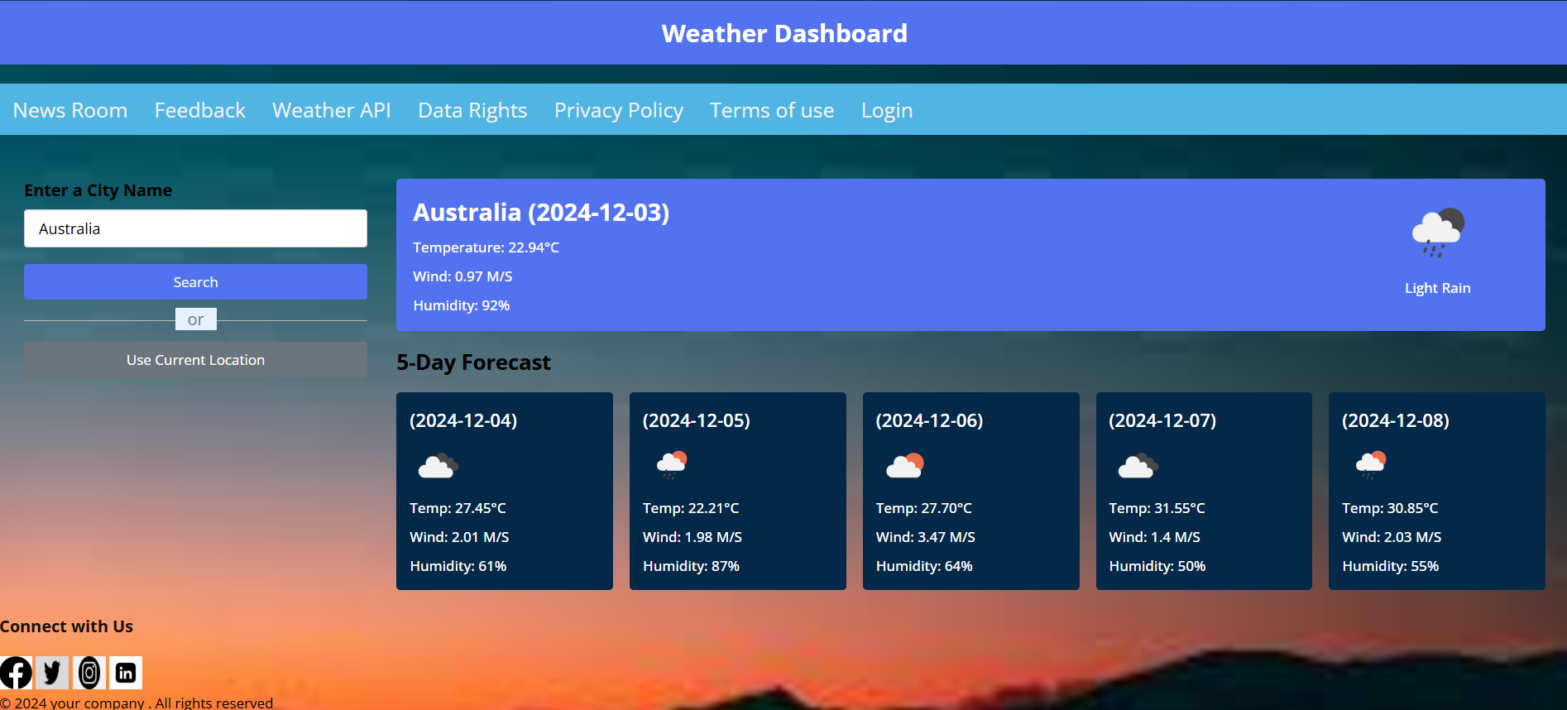
Website Interface
.

Slide 9
Why did I consider Building a weather app?
The weather website is a fulfilling project that serves a broad audience.
It helps me to better understand DOM manipulation, event handling, CSS styling, APIs, and more.
A weather website isn't just a functional platform—it's a versatile project with potential for innovation, profit, and meaningful impact.
Widely needed: high demand and utility which means weather websites are visited regularly.
Showcase skills: it’s an excellent project to demonstrate my ability in frontend and backend development, API usage, data visualization, and app design.
Complex data: weather data involves variables like temperature, humidity, wind, and forecasts, offering a chance to work with dynamic datasets
Data integration: building a weather app involves fetching and handling data from APIs like openweathermap, which helps you understand API integration and real-time data handling.
Building a weather app project allows me to apply my web development skills to a real-world application.

Slide 10
Problems faced during the process of development
Developing a weather application or website can present a variety of challenges. These range from technical hurdles to design considerations and external dependencies. Here are some common problems faced during the development process:
Data Acquisition Challenges :
Finding a weather data provider with high accuracy and reasonable costs.
Dealing with rate limits or restricted access to free API tiers.
API Integration:
Managing integration with APIs for smooth data flow and error handling in case of outages.
API Key Management which means Safeguarding API keys from unauthorized access or misuse.
Data Visualization:
Representing complex data (like wind patterns or storm trajectories) in a user-friendly way.

Slide 11
Future Improvements
Technology based
Performance based
Django or Flask (for web apps)
Tkinter (for desktop apps)
Kotlin/Java (for Android)
Swift (for iOS)
Flutter (Dart-based)
Python or Ruby
Rust
Php
Swing or JavaFX
IoT Integration
Blockchain for Data validation
Voice integration
3D visualizations
High-resolution, animated radar maps showing weather patterns.
AI-Powered Predictions
Heatmaps and Forecast Animations
API Monetization

Slide 12
Thank you
.

